Slide 1
Magnetic field diffusion in Molecular Clouds
M. R. M. Leão (IAG-USP), E. M. de Gouveia Dal Pino (IAG-USP), A. Lazarian (Univ. of Wisconsin), R. Santos-Lima (IAG-USP), G. Kowal (IAG-USP)‏
Understanding star formation is a central problem of modern astrophysics. In this work we are performing a numerical study of the collapse of a cloud of gas in the presence of magnetic field and turbulence in order to establish the relative importance between ambipolar diffusion and turbulent reconnection in the diffusion of the magnetic field. This research continues the recent study carried out by Santos-Lima et al. (2010) about the importance of magnetic reconnection in turbulent diffusive transport of the magnetic field out of a gravitational potential, allowing the inflow of mass. For this aim, we use a modified version of the numerical MHD-Godunov based code originally developed by Kowal & Lazarian (2007) and tested by Falceta-Gonçalves et al. (2008, 2010) and Leão et al. (2009).

Slide 2
INTRODUCTION
Astrophysical flows are known to be turbulent and magnetized, but the role played by MHD turbulence is still highly debated. We explore here the role of the turbulence in removing diffusively the magnetic field out a collapsing molecular cloud. In Santos-Lima et al. (ApJ, 2010, in press), we have shown that turbulent magnetic reconnection can be efficient in removing magnetic flux out of gravitational potential wells – allowing in this way the infall of the gas.
We are presently exploring this mechanism more realistically in molecular clouds, considering the effects of the self-gravity with different setups. We are studying the diffusion of the magnetic field, taking clouds initially in magneto-hydrostatic equilibrium with β constant or already collapsing (in free-fall).
The results here presented are still preliminary. We have developed several tools to make diagnostics of the transport of the magnetic field to out of the cloud. Initially we use 6 free parameters: cloud radius, density, and surface density, cloud and ambient sound speeds and the initial value of β in the cloud.

Slide 3
MHD Simulations
In order to check the model above, we performed fully 3-D dynamical simulations that take into account the effects of the turbulence, the magnetic fields and the self-gravity, in order to follow the late evolution of the material within the magnetized clouds and check whether it allow the transport of the magnetic field.
We have employed a grid Godunov-MHD code (Kowal & Lazarian ApJ, 2007; Falceta-Gonçalves et al. 2008, 2010).

Slide 4
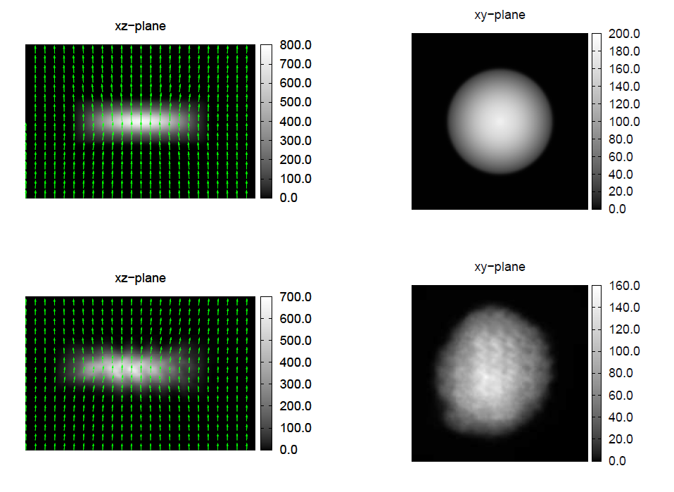
Maps of the projected density and magnetic field vectors. Top panels show the initial configuration of the cloud in magneto-hydrostatic equilibrium and bottom panels in the time t = 5.0 in code units (c.u.). The initial magnetic field is in z-direction. All the clouds used here have r = 3.6, ρ_{s} = 1.0, ρ_{i} = 1.4 and β = 0.5 in c.u.

Slide 5
Below, maps of the projected density distribution and magnetic vectors for a cloud initially out of equilibrium: a) at t=0, b) collapsing at t = 5.0 , and c) after the evolution of the turbulence at t = 5.0 c.
Diagnostics Tools
To try to determine if turbulent reconnection is efficient or not to remove the magnetic flux from a collapsing clump we have chosen some useful tools. First, we have built a bi-histogram of the magnetic energy compared with the gravitational energy aiming at detecting its potential decrease within the cloud and increase outside of it.

Slide 6
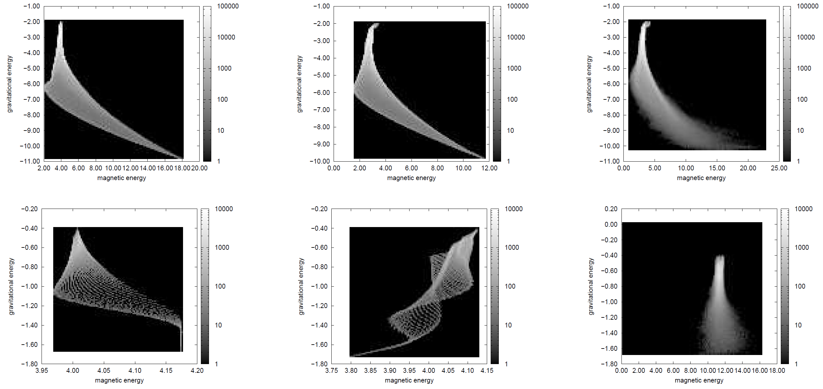
Below: the bi-histograms for the setup initially in magneto-hydrostatic equilibrium (left-top panel) and in free-fall (left-bottom panel), at t=0; at t = 5.0 without turbulence (center panels); and at t = 5.0 with turbulence (right panels).

Slide 7
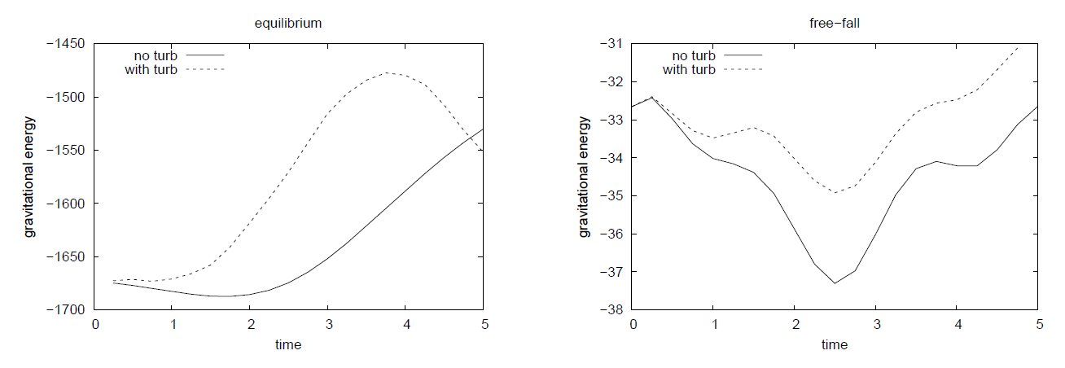
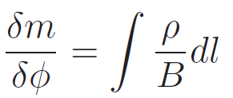
Below, graphics of the time evolution of the gravitational energy for the cloud starting in equilibrium (left) and out of equilibrium (right), with and without turbulence.
Finally, we have plotted histograms of the differential mass-to-flux ratio, dm/dΦ. We have taken
Integrated along magnetic field flux tubes, and chosen a minimal density as a threshold to identify the cloud material within the computational domain.

Slide 8
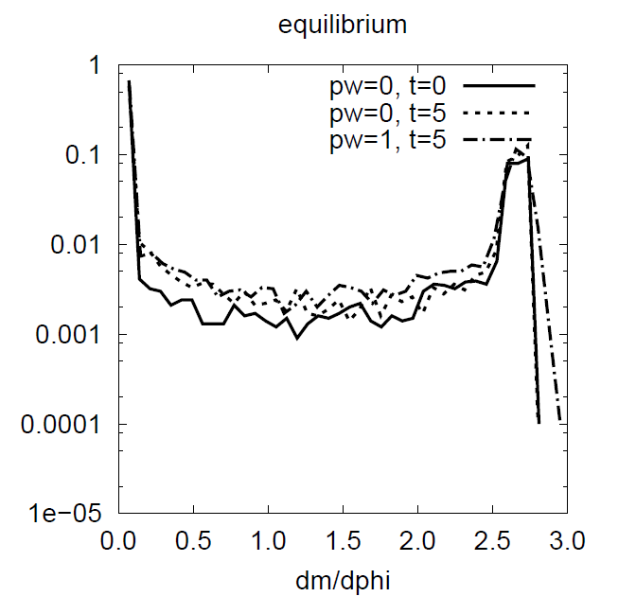
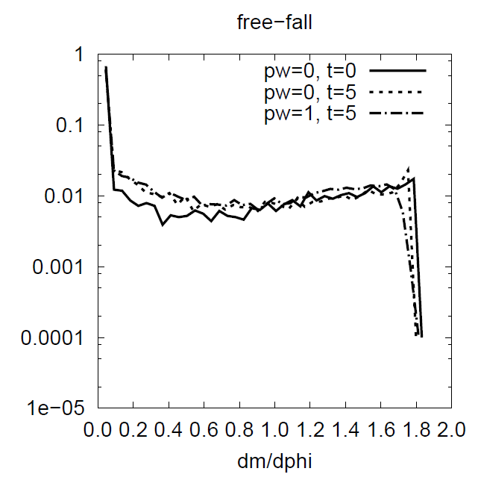
If the magnetic field is frozen into the cloud material, dm/dΦ should be constant for each differential flux tube.
On the other hand, if there is turbulent reconnection of the field lines then we expect to detect diffusive transport of the magnetic flux and therefore, flux-freezing violation. This should be evidenced by a broadening in the distribution of mass-to-flux ratio in the ‘differential’ flux tubes, with some accumulating more or less mass than initially.

Slide 9
The panels above indicate a distinct evolution of the mass-to-flux ratio both for a cloud starting in equilibrium and one starting out of the equilibrium. For the initial parameters studied so far, we don’t see significant changes in this ratio within the cloud. This apparent lack of significant diffusion of the magnetic field is contradictory to the former results of Santos-Lima et al. (2010) and may be due to the poor numerical resolution employed in the present preliminary tests. This can lead to an ambiguous determination of the real quantity of mass within differential flux tubes. We still have to make further tests at higher resolution and sweeping a larger parameter space in order to give a definitive answer in this regard.
As a matter of fact, we see an enhancement of the gravitational energy within the cloud in the presence of turbulence which is higher in the equilibrium case than in the free-fall case.
We can observe further in the diagrams of mass-to-flux ratio for a cloud starting in equilibrium a small difference in distribution when turbulence is included.

Slide 10
References
Falceta-Goncalves D., Lazarian A., Kowal G., 2008, ApJ, 679,
Falceta-Goncalves D., de Gouveia Dal Pino E.M., Gallagher, J.S., Lazarian A., ApJ Lett. , 2010
Kowal G., Lazarian A., 2007, ApJ, 666, L69
Leão, M. R. M., de Gouveia Dal Pino, E. M., Falceta-Gonçalves, D., Melioli, C., Geraissate, F. G., 2009, MNRAS, 394, 157
Santos-Lima R., Lazarian A., de Gouveia Dal Pino E.M., Cho J. 2010, ApJ, in press
Tomisaka, K., Ikeuchi, S., Nakamura, T., 1988, ApJ, 326, 208.

